Slide 1
Table of Contents

Slide 2
Description of Software Architecture and Target Environment
The software we are designing will be able to take a pdf input of research from a user and then create a summarized PowerPoint with or without photos based on the user's preference.

Slide 3
Figure Process Model of PDF to PPT Converter
This project will allow the user to take in a PDF file and have it converted into a PowerPoint presentation. The user will be able to select whether they want the PowerPoint to have images or not. The user will also be able to download the PowerPoint once it is converted.

Slide 4
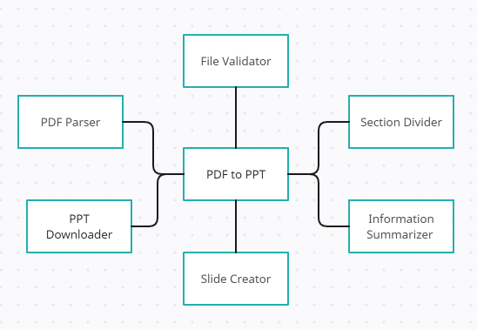

Slide 5
PowerPointGenerator class will do this by passing the reduced text and image research chunk
This project will take a PDF file and convert it into a PPT file. The PDF file will be analyzed and reduced to only the most relevant information. The reduced information will be used to create slides in the PPT file.

Slide 6
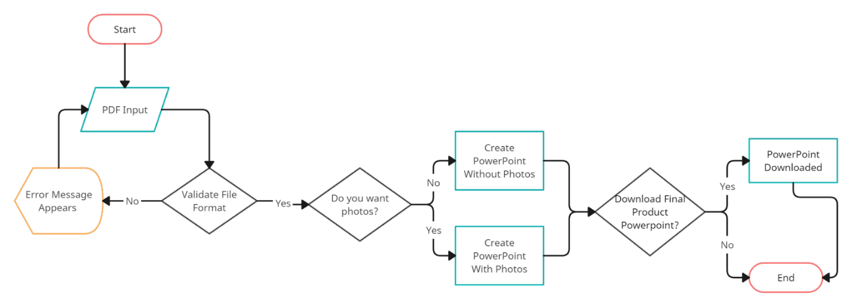

Slide 7
Class Details
This project involves developing a Pythonbased tool that can parse research paper documents and generate a summary in the form of a PowerPoint presentation. The tool will use a set of classes to encapsulate the functionality for processing text, images, and generating slides.

Slide 8
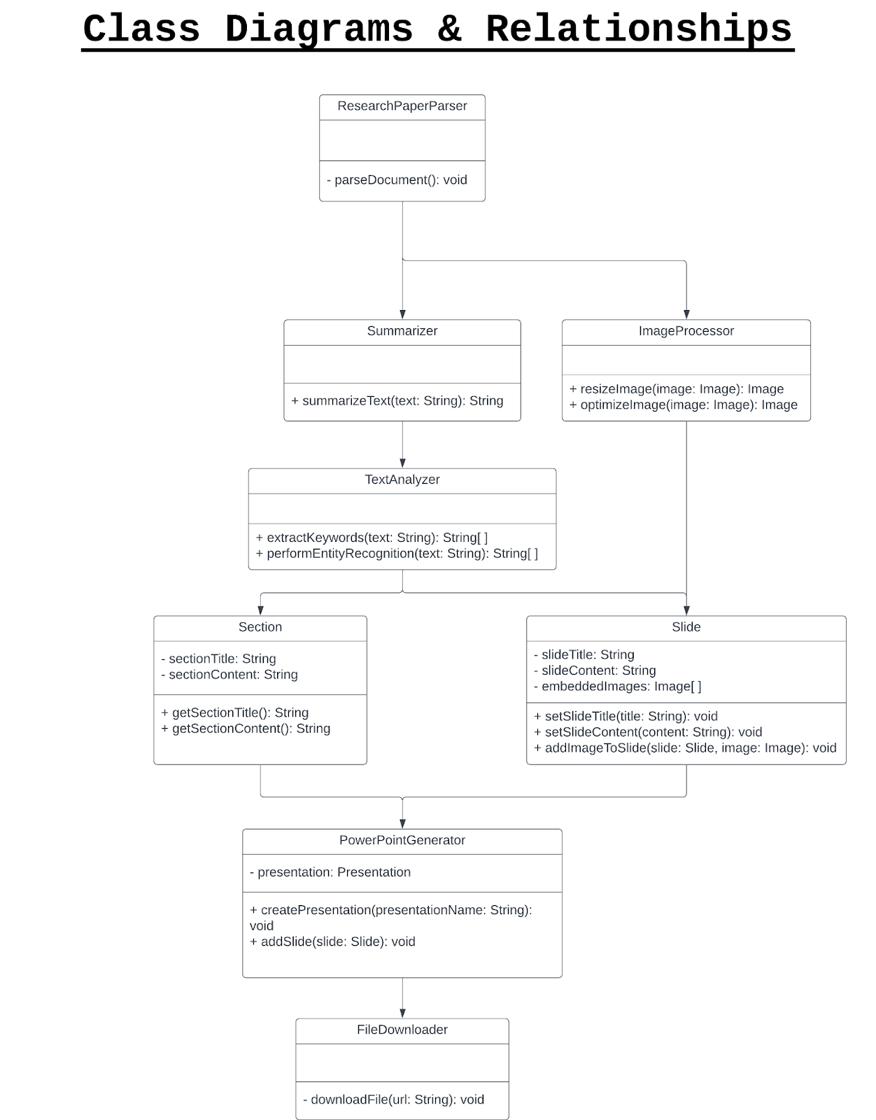

Slide 9
Design Issues
Design issues are problems that arise during the design phase of the software development process. They can be functional, nonfunctional, or both. Functional issues are those that affect the functionality of the software. Nonfunctional issues are those that affect the structure or organization of the software. Design issues can be solved through careful planning and consideration during the design phase.

Slide 10
Class Interdependencies Classes could depend too closely on each other which could result
The main issues that can come up when creating a program are: Class interdependencies Error handling Scalability and performance Data persistence and storage during execution

